Slide 1
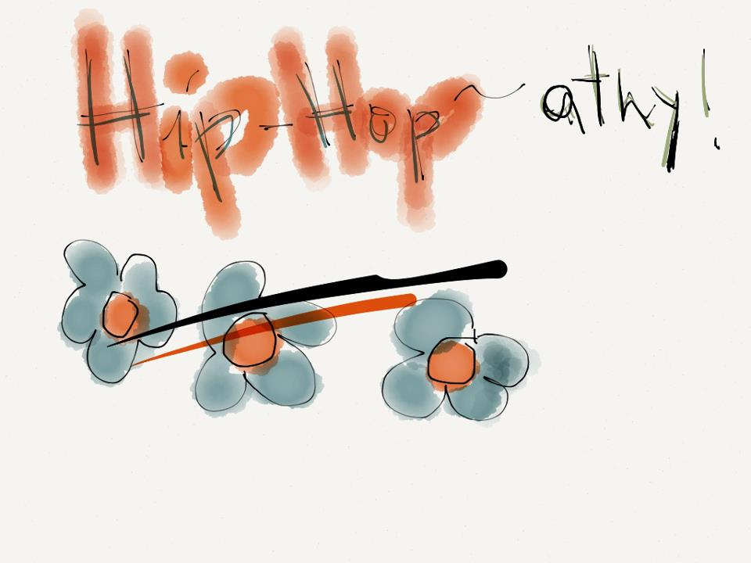
Omoju Miller
EDUC 220 – Design of Learning Technologies

Slide 2
Design Problem

Slide 3
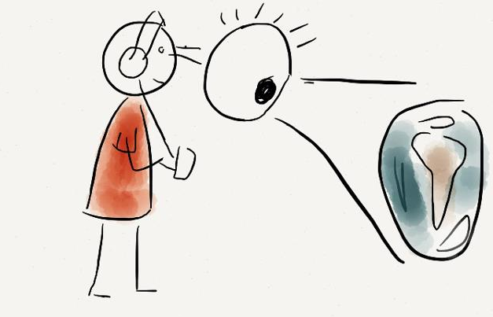
Teaching people reasoning perspectives
Identify conceptual frames used to generate knowledge
Why?
Because communication is becoming global
Because we have to interact across cultures
When you understand another’s conceptual frame you can communicate more effectively

Slide 4
Guiding Theory - Rationale

Slide 5
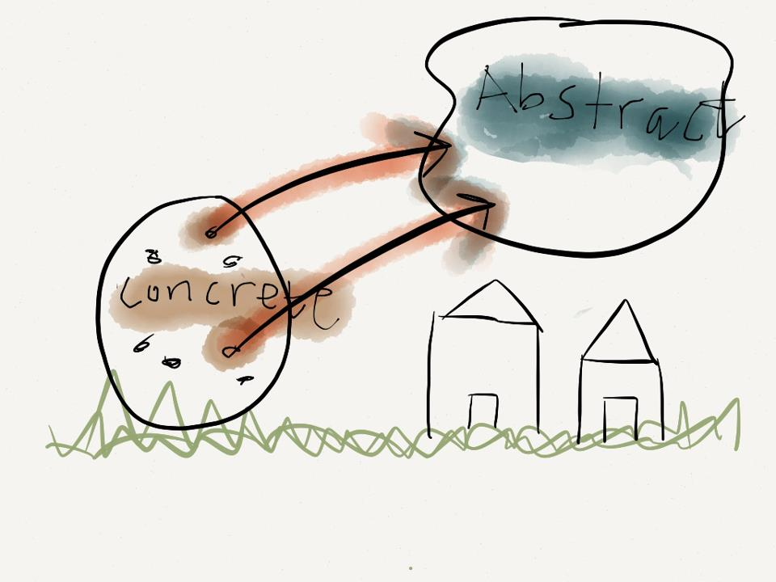
Conceptual Metaphor theory
Understanding of a concrete domain to reason about abstract domain
The markets rose today
Conceptual Metaphor: More is Up
Frames: Quantity and Verticality
Gain conceptual metaphors
Sensorimotor Experience
Perceptual Experience
Culture
Basis of human cognition and its unconscious

Slide 6
Why Hip-Hop?

Slide 7
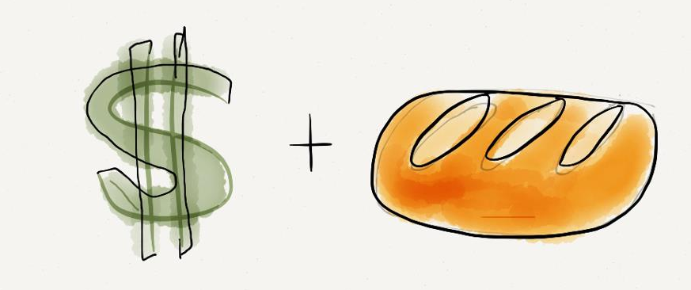
Hip-Hop is a cultural universal
Sub-culture that is prone to being misunderstood
Unusual conceptual metaphors!
I’m only slingin rap to your kids
RAP MUSIC IS NARCOTIC STREET TRADE
Novel linguistic realizations overflows!
Baked a lot of bread and kept it off the books
MONEY IS SUSTENANCE

Slide 8
Design Decisions
Built the hipopathy app
Django
Python Web Framework
Integrate with other existing modules
Desire to eventually lunch online

Slide 9
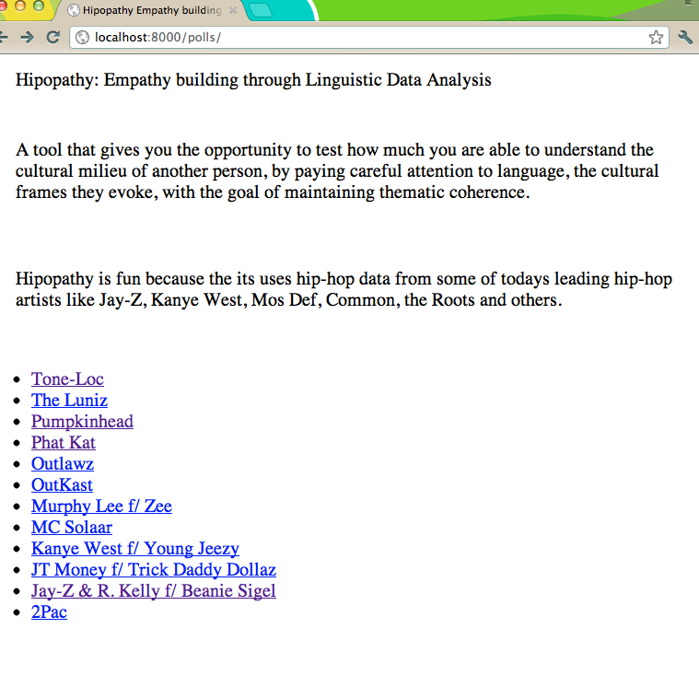

Slide 10
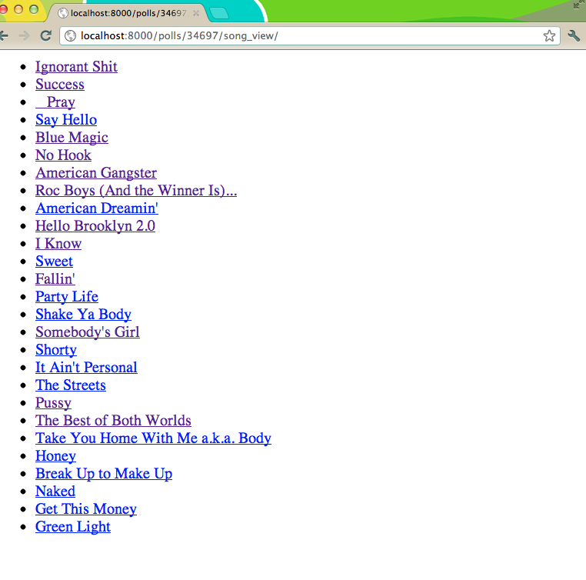

Slide 11
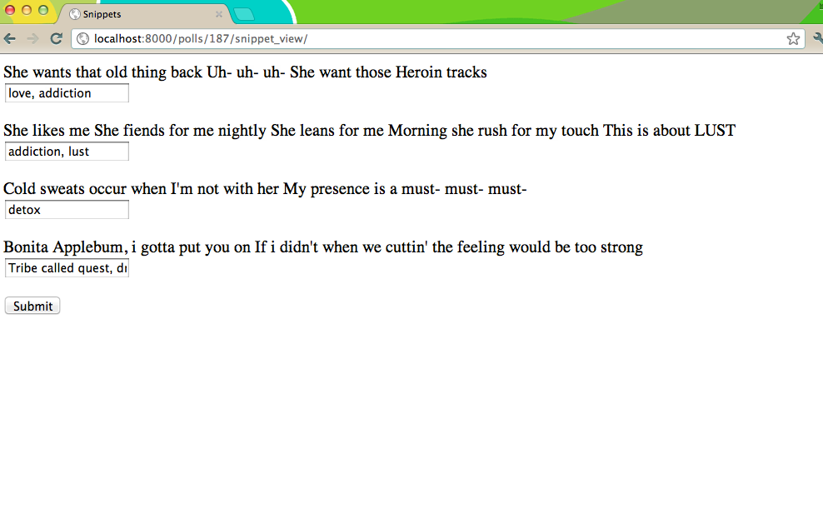

Slide 12
The user started censoring what really came to their mind
They were not sure if they should write down the emotion it conjured up versus the image that popped into their mind
They were not sure if they could use the same words over and over again
“I have learnt more about addiction that I ever thought.”
“This song is so complex!”

Slide 13
Main Findings
Difficulty in reporting what you are thinking about
Increased scaffolding on
What a conceptual frame is
Explicitly state and restate the goal of the exercise
Try to match the writer’s reasoning by writing down conceptual frames

Slide 14
Future Work
Create a video that talks about the project and shows a demo
Implement a better version of comparison
Build a visualization of concepts
Add a feature that lets people highlight words that suggest the frames
Keep a record of old work
People can see progression over time
Add more songs

